Slide 1
N-Terminal Resistors
3-terminal or 2-port
d₁
i₁
i₂
d₂
i₁
i₂
3-terminal
+
+
+
+
v₁
2-port
v₁
v₂
v₂
_
_
_
_
d₃
Terminal variables for a 3-terminal: v₁ ,v₂ , i₁ , i₂
Terminal variables for a 2-port: v₁ ,v₂ , i₁ , i₂
d₁
i₁
i₂
d₂
+
+
v₁
v₂
_
_

Slide 2
Different Representations
For a 1-port(2-terminal) there are two representations
For a 2-port(3-terminal) there are ........... representations
Why?
Current-controlled:
Voltage-controlled:
Hybrid-1:
Hybrid-2:
Transmission-1:
Transmission-2:

Slide 3
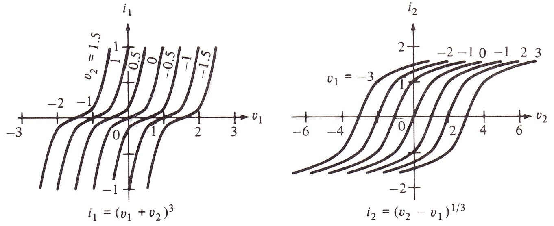
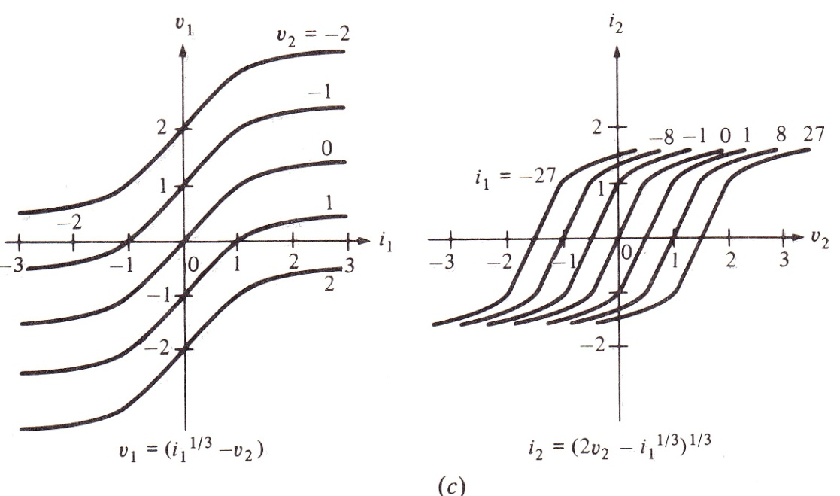
An Example
Voltage-controlled
Hybrid-1
L.O. Chua, C.A. Desoer, S.E. Kuh. “Linear and Nonlinear Circuits” Mc.Graw Hill, 1987, New York

Slide 4
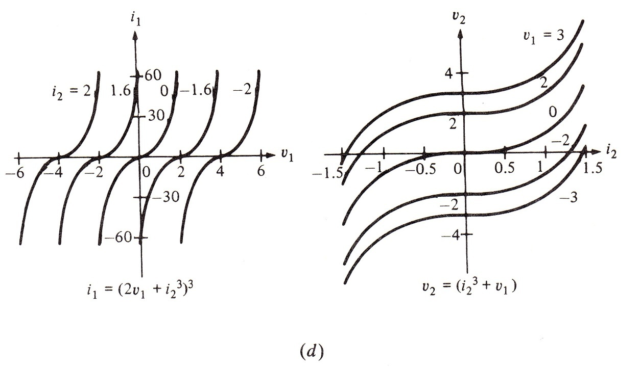
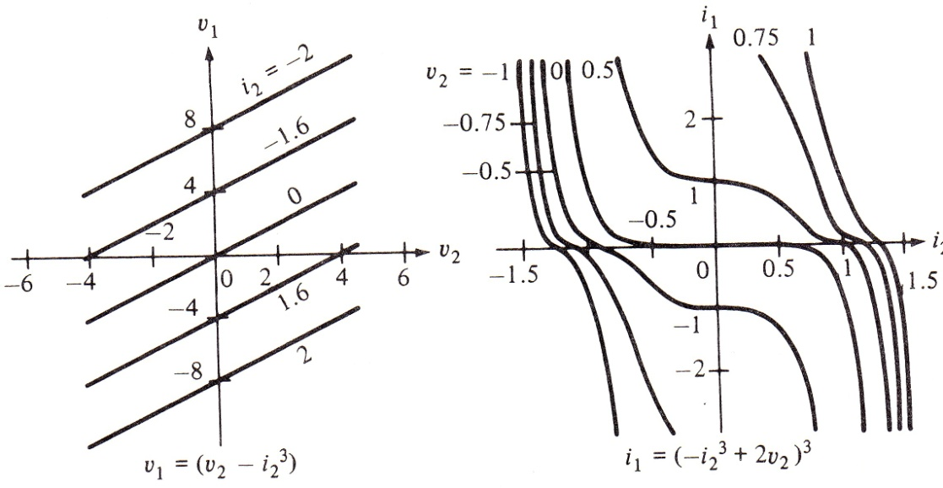
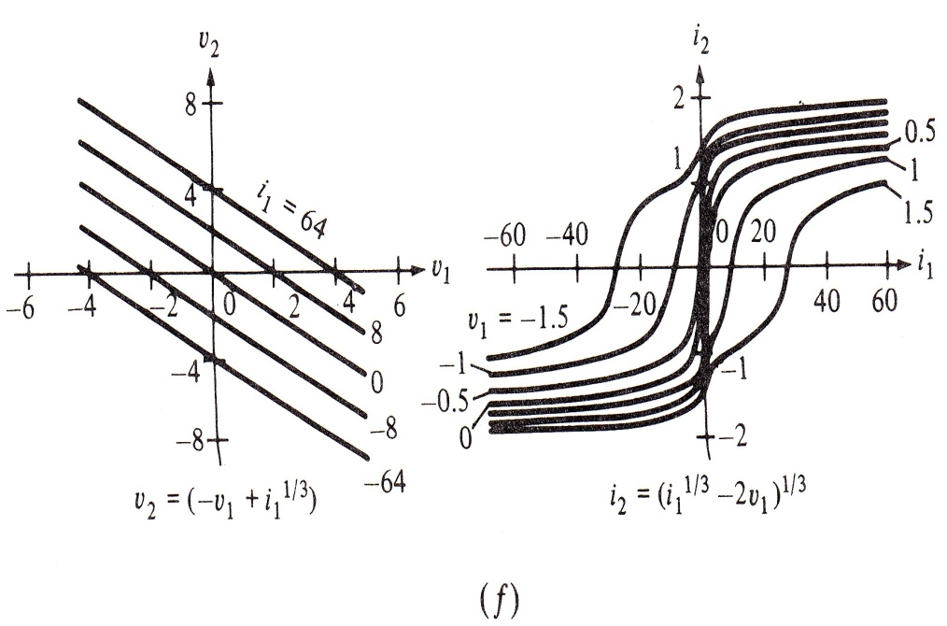
Hybrid-2
Transmission-1
Transmission-2
L.O. Chua, C.A. Desoer, S.E. Kuh. “Linear and Nonlinear Circuits” Mc.Graw Hill, 1987, New York

Slide 5
Six Representations for Linear 2-ports
If functions are linear then they act like matrices:
Current-controlled:
i₁
i₂
+
+
v₁
v₂
_
_
N
Voltage-controlled:
i₁
i₂
+
+
+
+
_
v₁
_
v₂
_
_
N

Slide 6
Hybrid-1:
i₁
i₂
+
+
+
v₁
_
v₂
_
_
N
Hybrid-2
i₁
i₂
+
+
+
_
v₁
v₂
_
_
N
Transmission-1
Transmission-2

Slide 7
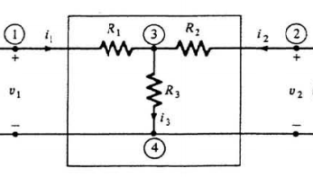
How To Obtain A Representation For Linear 2-ports
There are two ways: 1) All in one go 2) Each parameter seperately
1) All in one go: Connect appropriate sources to the ports according to the type of the representation. Write KCL and KVL equations and element equations for the elements in 2-port. Use these to find the representation.
EXAMPLE:
Find the current-controlled representation for the following 2-port:

Slide 8
2) Each parameter seperately: Check the representation and express the parameter in terms of port variables. From this you will see that you need to connect a voltage or current source to one of the ports and the other port needs to be left either as a short-circuit or as an open circuit. Use this circuit to find the parameter, again using KVL,KCL and element equations.
For instance, for finding r₁₁ .....
i₁
i₂=0
+
+
v₁
v₂
_
_
For finding g₂₁ .....

Slide 9
EXAMPLE:
Find hybrid-2 representation for the following 2-port:
L.O. Chua, C.A. Desoer, S.E. Kuh. “Linear and Nonlinear Circuits”, Mc.Graw Hill, 1987, New York

Slide 10
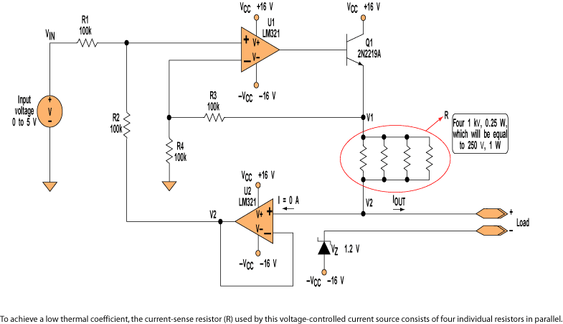
Some Linear 2-ports
Current controlled voltage source
i₁
i₂
+
+
+
v₁=0
_
r_{m}i₁
v₂
_
_
Voltage conrolled current source
i₁=0
i₂
+
+
v₁
g_{m}v₁
v₂
_
_

Slide 11
Current controlled current source
i₁
i₂
+
+
v₁=0
αi₁
v₂
_
_
Voltage controlled voltage source
i₁=0
i₂
+
+
+
v₁
_
µv₁
v₂
_
_

Slide 12
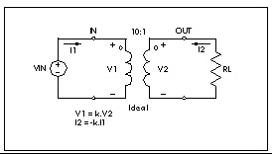
Ideal transformator
n:1
Gyrator
i₁
i₂
G
+
+
v₁
v₂
_
_

Slide 13
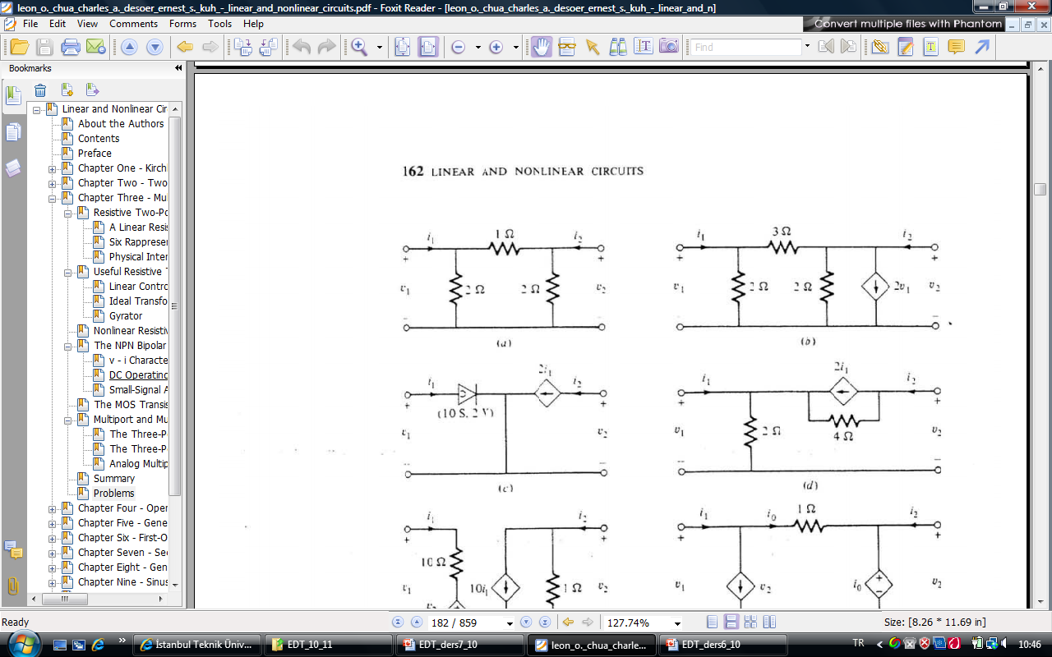
Obtain the element equations for the following 2-port!
L.O. Chua, C.A. Desoer, S.E. Kuh. “Linear and Nonlinear Circuits”, Mc.Graw Hill, 1987, New York

Slide 14
+
V₁₂
_
1
+
İ₁ (t)
İ₂ (t)
+
2
1
2
3-terminal element
V₁₃
V₂₃
3
İ₃ (t)
Figure 2
_
_
3
Figure 1
The element equation for the element in Figure 1 is given below:
Find the element equation in terms of the quantities given in the element graph in Figure 2.
b) Construct a 3-terminal element that has this element equation using only 2-terminal linear resistors and some dependent sources.

